Slide 1
High-Frequency Trading Module 3: Quantitative and hft strategies
Slides to accompany High-Frequency Trading: A Practical Guide to Algorithmic Strategies and Trading Systems, 2nd edition, by Irene Aldridge

Slide 2
Outline
What is Quantitative Analysis?
Quantiative strategies
Momentum
Statistical arbitrage
Event trading
High frequency strategies
Statistical arbitrage
Event trading
Market making

Slide 3






1. What is a Quantitative Strategy?
Technical Analysis
Fundamental Analysis
Portfolio Management
A Quantitative Investing Strategy:
1. More financial instruments; 2. Higher Accuracy; 3. Better Performance
$$f\left(x\right)=a_{0}$$
$$V$$
$$\sqrt{a_{0}}$$
$$σ$$
$$\int{S(x)}f\left(x\right)dx$$
$$\sum{∆P}$$

Slide 4
1. Methodology Relationships…
Traditional
Quantitative
Technical analysis
identifies patterns in price movements with a naked eye
Fundamental analysis
considers fundamental “factors” affecting prices
Portfolio management
optimizes combinations of instruments; includes hedging
Quantitative analysis
uses data modeling to identify patterns
Quantitative analysis
can take fundamental factors as inputs into models
Quantitative analysis
uses portfolio management techniques to optimize investment allocation

Slide 5
1. A Quantitative Model…
Representation
Implementation
Closely tracks observed data (e.g., prices)
Using some other observed data (e.g., GDP)
In a mathematical relationship
Usually, modeled with help of software
Julia
Mathematica
MatLab
Python …
Model
1.
Idea
2.
Data
3. Software

Slide 6
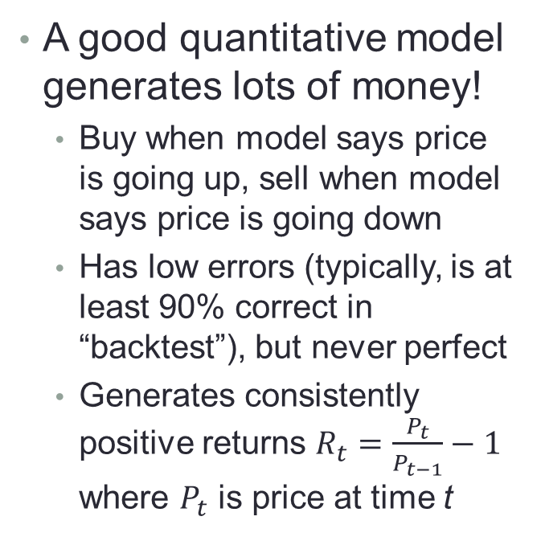
1. Accuracy of a Quantitative Model
Quant model = Close representation
What model is a good model?
Quantitative models predict data of interest
Will the price on IBM go up or down?
Errors exist
Example: IBM price may be consistent with a given forecast only 87% of the time
An objective of a quantitative analyst is to minimize prediction errors
A good quantitative model generates lots of money!
Buy when model says price is going up, sell when model says price is going down
Has low errors (typically, is at least 90% correct in “backtest”), but never perfect
Generates consistently positive returns $R_{t}=\frac{P_{t}}{P_{t−1}}−1$ where $P_{t}$ is price at time t

Slide 7
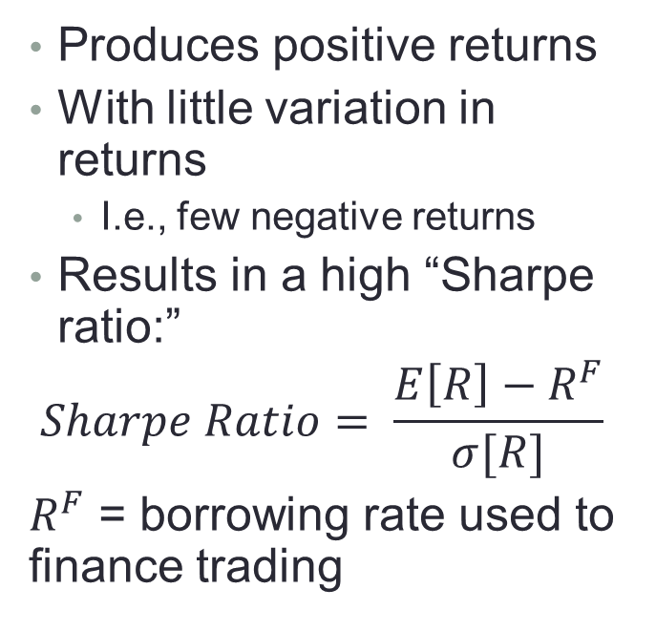
1. A good quantitative model…
Produces high, precise returns
Return distributions
Produces positive returns
With little variation in returns
I.e., few negative returns
Results in a high “Sharpe ratio:”
$$Sharpe Ratio= \frac{E\left[R\right]−R^{F}}{σ[R]}$$
$R^{F}$ = borrowing rate used to finance trading
2. Better model
3. Worse
model
1. Good model
0
Trade, Daily or Monthly Returns

Slide 8
2. Basic definitions
Return
Volatility
Maximum drawdown
Win ratio
Avg gain/loss
Correlation
Alpha
Beta
Skewness
Kurtosis

Slide 9
2. Basic definitions: Return
Return can be expressed:
In dollar value
Most often, as a percentage
Allows easy cross-strategy and cross-asset comparison of performance, independent of the starting price
Illustration
P, Price or Net Asset Value (NAV)
t1
t2
time

Slide 10
2. Basic definitions: Volatility
Measures how much the return moves up and down
Is often taken to proxy risk
Intuitively:
Low volatility
High volatility
At least a dozen measures of volatility exist, each measured per standardized period (round-trip trade, day, month):
Standard deviation
Simple (most popular)
Weighted (later observations count more than earlier observations)
Average of Open, High, Low, Close
High Minus Low
Average square intraday returns
…
Price or NAV
time
Price or NAV
time

Slide 11
2. Basic definitions: Drawdown
Drawdown is a measure of historical and potential loss
Maximum loss relative to the highest previous value or “watermark”
Managers typically receive performance fees only after exceeding the highest watermark
Maximum drawdown helps explain potential downside
Example 1
Example 2
Price or NAV
|Drawdown 2| >
|Drawdown 1|
time
Price or NAV
|Drawdown 1| > |Drawdown 2|
time

Slide 12
2. Basic definitions: Win ratio
What portion of the trades/days/months ended profitably?
Win ratio helps
compare “signals” of strategies
monitor run-time performance (is run-time win ratio consistent with prior performance?)
Example:
Monthly day-by-day win ratio of a strategy
A decline in the win ratio may indicate that the strategy is reaching capacity

Slide 13
2. Basic definitions: Avg Gain/Loss
Measures related to drawdown:
When the strategy gains, what is the average gain?
When the strategy loses, what is the average loss?
Best used together with win ratio:
High win ratio may tolerate lower avg gain
Lower win ratio requires higher avg gain
Basic check of reported statistics:
 | High WinRatio | Low WinRatio
High |  | High drawdowns
Low | High volatility | 

Slide 14
2. Basic definitions: Correlation
Measures co-movement of strategy returns with those of another strategy or security
Low correlation => high diversification
Simple correlation:
Asymmetric correlation is more informative
Example:
Two ETFs: SPY (SPDR S&P 500) and GLD
Simple correlation (2010-2011 daily return data):
5.6%
Asymmetric correlation:
On days when SPY > 0: Corr[SPY, GLD] = 4.3%
On days when SPY < 0:
Corr[SPY, GLD] = -6.6%
GLD has been a good diversifier of SPY: when SPY < 0, GLD can be > 0

Slide 15
2. Basic definitions: Alpha and Beta
Derived from Capital Asset Pricing Model (CAPM)
Alpha and Beta measure the cause and effect relationships between two securities (sometimes with lagged returns)
Beta measures the impact of RM on Ri
Alpha (the intercept) measures the “excess return” of Ri
High Beta shows little opportunity for diversification
High and statistically significant Alpha is desirable
Example:
Ri
*
*
*
*
*
*
*
*
*
*
RM

Slide 16
2. Basic definitions: skewness and kurtosis
Skewness describes tendency to skew to +ve or –ve side
Zero-skewness:
Positive skewness:
Negative skewness:
Kurtosis measures the likelihood of extreme occurrences
Normal kurtosis
High kurtosis
Low kurtosis

Slide 17
Presentation Roadmap
Outline
Why Statistical Methods?
Basic definitions
Key metrics
Performance attribution
Capacity Evaluation
Required length of track record
Performance Monitoring
Key topics
Comparative performance of investment strategies
Fast detection of abnormal performance
Impact of external factors
Strategy capacity
Required length of track record

Slide 18
3. Key Metrics
Example
Sharpe ratio
Average excess return per unit risk
Does not take into account tail risk
Conditional Sharpe ratio
Accounts for skewness, S, and excess kurtosis, EK, of returns
E[r]
Portfolio M
Portfolio A
Slope = Sharpe ratio

Slide 19
Presentation Roadmap
Outline
Why Statistical Methods?
Basic definitions
Key metrics
Performance attribution
Capacity Evaluation
Required length of track record
Performance Monitoring
Key topics
Comparative performance of investment strategies
Fast detection of abnormal performance
Impact of external factors
Strategy capacity
Required length of track record

Slide 20
4. Performance Attribution
Consider Capital Asset Pricing Model (CAPM) again.
If Beta is high and Alpha is low, it may be cheaper and more effective to invest into RM instead of Ri
Lower transaction costs
Often lower drawdown risk
Lower liquidation risk
Example:
A trading strategy trades at least once a week
Relative to the SPDR S&P 500 ETF (SPY), the strategy has
Alpha of –0.01 (-1%)
Beta of 0.99 (99%)
It is cheaper and more effective to buy and hold SPDR S&P 500 ETF

Slide 21
Presentation Roadmap
Outline
Why Statistical Methods?
Basic definitions
Key metrics
Performance attribution
Capacity Evaluation
Required length of track record
Performance Monitoring
Key topics
Comparative performance of investment strategies
Fast detection of abnormal performance
Impact of external factors
Strategy capacity
Required length of track record

Slide 22
5. Capacity Evaluation
Several considerations:
Which markets/securities does the strategy trade? How liquid is each traded security?
What is the average and median trade sizes?
What is the average and median sizes at best bid and best ask?
How often does the strategy trade?
Does the order type matter?
Does the strategy rely primarily on market orders or limit orders?
Key question:
What is the maximum size of the traded position given the strategy reaches its profitability goals?
Key measurements
1. Market impact of the previous trade “slice”, MIt-1
2. Expected execution price, Et-1[Pt]
3. Probability of execution, Prt[Execution]
4. Execution cost, Ct

Slide 23
5.1. Capacity Evaluation – market impact
Market impact
Market impact matters for sequential orders
Both limit orders and market orders generate market impact
Market impact may make trading more or less expensive
Research shows that limit orders generate the opposite market impact
Size of limit order market impact ~ -1/4*(size of comparable market order impact)
Market impact, an illustration
Price
market
impact
Market buy order
time
Price
market
impact
Limit buy order
time
Limit orders tend to lower prices, good for follow-up market orders

Slide 24
5.2. Capacity Evaluation – probability of execution
Probability of execution
Market orders have guaranteed execution
Limit orders only execute when:
The order appears at the top of the book, AND
An opposite market order arrives or a cross-price opposite limit order arrives
Probability of executing a market order = 1
Probability of executing a limit order <= 1
Limit orders incur the “risk of non-execution”
A market order “takes” the best price available on the other side of the order book
A limit order “sits” in the book until a suitable counter order arrives
Price realized by a market sell
Price realized by a market buy
Shaded limit sell order is not executed
until limit orders ahead are gone

Slide 25
5.3 Capacity Evaluation – execution price
Execution price
What is the realized trade price?
Price is fixed in limit orders
Price is subject to slippage in market orders
Slippage is subject to arrival of new limit and market orders
Other market orders may “sweep” through the book, eating up liquidity and driving market prices
Example:
Slippage = Realized price – Expected price
Expected price, E[P]
A market sell order arrives and takes off the
best bid
Realized price, P
The next market sell order may be matched
against a worse price

Slide 26
5.4 Capacity Evaluation – execution cost
Execution cost
What are the costs of trading?
Fees in market orders
Clearing fee
Routing fee
Government tax
Broker commission
…
Fees + rebates in limit orders
In addition to fees, exchanges may offer rebates to attract liquidity
Examples:
NYSE rebates of 0.0013% to 0.0020% for limit orders
NYSE fee: 0.0021% for market orders
Exchanges are
“normal” – taking a large fee for market orders and paying a large rebate for posting liquidity
“inverted” – taking a small fee for market orders and paying a small rebate for posting liquidity

Slide 27
5. Capacity Evaluation
Does the strategy
use market orders?
What is the
max liquidity at
profitable prices?
Yes
Can market and limit
orders be sequenced to
increase capacity?
Does the strategy
use limit orders?
What size
can execute at
given prices?
Yes
How does current cost
structure affect capacity?

Slide 28
Presentation Roadmap
Outline
Why Statistical Methods?
Basic definitions
Key metrics
Performance attribution
Capacity Evaluation
Required length of track record
Performance Monitoring
Key topics
Comparative performance of investment strategies
Fast detection of abnormal performance
Impact of external factors
Strategy capacity
Required length of track record

Slide 29
6. Required length of track record
Many portfolio managers require a minimum 2-year or 3-year track record
“because it’s always been done this way”
Reality:
By the “Central Limit Theorem” in statistics, a minimum of about 30 observations is required to ascertain statistical significance
2 years: 24 monthly observations
3 years: 36 monthly observations
When performance is not reported monthly, different lengths of observations are required
If Sharpe Ratio (SR) is used as a comparative performance metric (returns are assumed to be normal),
T_{min} = (1.645²/SR²)(1 + 0.5SR²).
in time units in which performance is reported

Slide 30
6. Required length of track record
Minimum Trading Strategy Performance Evaluation Times Required for Verification of Reported Sharpe Ratios
Claimed Annualized Sharpe Ratio
No. of Months Required (Monthly Performance Data)
No. of Months Required (Daily Performance Data)
0.5
130.95
129.65
1.0
33.75
32.45
1.5
15.75
14.45
2.0
9.45
8.15
2.5
6.53
5.23
3.0
4.95
3.65
4.0
3.38
2.07

Slide 31
Presentation Roadmap
Outline
Why Statistical Methods?
Basic definitions
Key metrics
Performance attribution
Capacity Evaluation
Required length of track record
Performance Monitoring
Key topics
Comparative performance of investment strategies
Fast detection of abnormal performance
Impact of external factors
Strategy capacity
Required length of track record

Slide 32
7. Performance Monitoring
How do you know…
that the manager continues to use the same strategy?
that the strategy is performing at prior levels?
that you can continue to expect similar returns?
Use a simple time series test to answer these questions
Run the analysis on all data, and then using a “rolling window”
If everything remains the same, betas in each rolling window will be statistically similar
If betas are not statistically similar from one window to the next:
The strategy may have changed
The data can be corrupted

Slide 33
Presentation Roadmap
Outline
Why Statistical Methods?
Basic definitions
Key metrics
Performance attribution
Capacity Evaluation
Required length of track record
Performance Monitoring
Key topics
Comparative performance of investment strategies
Fast detection of abnormal performance
Impact of external factors
Strategy capacity
Required length of track record

Slide 34
Ratios
CAPM-based Ratios
Lower-partial Moment Ratios
Drawdown Ratios
VaR Ratios

Slide 35
CAPM-based Ratios
CAPM-based Ratios
Sharpe Ratio
Treynor Ratio
Jensen’s Alpha

Slide 36
Sharpe Ratio (1966)
Adequate if returns are normally distributed
For HFT:

Slide 37
Treynor Ratio
β_{i} is the regression coefficient of trading returns on returns of the investor’s reference portfolio, such as the market portfolio.
Adequate if returns are normally distributed and the investor wishes to split his holdings between one trading strategy and the market portfolio.

Slide 38
Jensen’s Alpha (Jensen (1968))
β_{i} is the regression coefficient of trading returns on returns of the investor’s reference portfolio, such as the market portfolio.
Measures trading return in excess of the return predicted by CAPM. Adequate if returns are normally distributed and the investor wishes to split his holdings between one trading strategy and the market portfolio, but can be manipulated by leveraging the trading strategy.

Slide 39
Lower-partial Moment Ratios
Lower-partial Moment Ratios
Omega ratio
Sortino ratio
Kappa 3 ratio
Upside potential ratio

Slide 40
Lower partial moment
Measures based on lower partial moments (LPMs):
LPM of order n for security i:
where τ is the minimal acceptable return;
n is the moment: n = 0 is the shortfall probability, n = 1 is the expected shortfall, n = 2 for τ = E[r] is the semi-variance.
According to Eling and Schuhmacher (2007), more risk- averse investors should use higher order n.
LPMs consider only negative deviations of returns from a minimal acceptable return. As such, LPMs are deemed to be a better measure of risk than standard deviation, which considers both positive and negative deviations (Sortino and van der Meer (1991)). Minimal acceptable return can be 0, risk-free rate, or average return.

Slide 41
Omega Ratio
Shadwick and Keating (2002), Kaplan and Knowles (2004)
is the average return in excess of the benchmark rate.

Slide 42
Sortino Ratio
Sortino and van der Meer (1991)
is the average return in excess of the benchmark rate.

Slide 43
Kappa 3 Ratio
Kaplan and Knowles (2004)
is the average return in excess of the benchmark rate.

Slide 44
Upside Potential Ratio
Sortino, van der Meer, and Plantinga (1999)
where HPM = higher partial moment
According to Eling and Schuhmacher (2007), this ratio gains from the consistent application of the minimal acceptable return τ in the numerator as well as in the denominator.

Slide 45
Drawdown-based Ratios
Drawdown-based Ratios
Calmar Ratio
Sterling Ratio
Burke Ratio
Measures based on drawdown: frequently used by CTAs, according to Eling and Schuhmacher (2007, p.5), “because these measures illustrate what the advisors are supposed to do best—continually accumulating gains while consistently limiting losses (see Lhabitant, 2004).” denotes the lowest maximum drawdown, the second lowest maximum drawdown, and so on.

Slide 46
Calmar Ratio
Young (1991)
MD_{i1} is the maximum drawdown.

Slide 47
Sterling Ratio
Kestner (1996)
is the average maximum drawdown.

Slide 48
Burke Ratio
Burke (1994)
is a type of variance below the N^{th} largest drawdown; accounts for very large losses.

Slide 49
VaR Ratios
VaR Ratios
Excess return on value at risk
Conditional Sharpe ratio
Modified Sharpe ratio
Value at risk ( ) describes the possible loss of an investment, which is not exceeded with a given probability of in a certain period. For normally-distributed returns,
, where is the α-quantile of the standard normal distribution.

Slide 50
Excess return on value at risk
Dowd (2000)
Not suitable for non-normal returns.

Slide 51
Conditional Sharpe ratio
Agarwal and Naik (2004)
The advantage of CVaR is that it satisfies certain plausible axioms (Artzner et al. (1999)).

Slide 52
Modified Sharpe ratio
Gregoriou and Gueyie (2003)
Cornish-Fisher expansion is calculated as follows:
where Si denotes skewness and the excess kurtosis for security i (Favre and Galeano, 2002).
Suitable for non-normal returns.

Slide 53
Outline
What is Quantitative Analysis?
Quantitative strategies
Momentum
Trend following
Event trading
Mean reversion = statistical arbitrage
Basic case
Relative value
Basket tracking
High frequency strategies
Trend following
Statistical arbitrage
Market making

Slide 54
2. Low-frequency Quant Strategies
2.1. Momentum
2.2. Mean-Reversion
trend
Price
Price
mean
Time
Time
EVERYTHING IS RELATIVE: mean can be time-varying

Slide 55
2.1. Momentum
Momentum = Trend following
Famous 1993 momentum
If something is rising,
Chances are it will continue rising
If something is falling,
Chances are it will continue falling
Take all stocks
Identify those that rose the most in the past month (“winners”)
Identify those that fell most in the past month (“losers”)
Buy winners, sell losers.
Close out positions 2 months later.
Realize gain (in 1993).
This is an example of behavioral herding strategy

Slide 56

2.1. Identification of Momentum
Basic Way
Sophisticated way
Moving average (MA) cross-overs in technical analysis
If shorter-term MA crosses over longer-term (MA), then there is a potential trend developing.
Compute a Hurst coefficient
Hurst coefficient drives fractals
If Hurst > 0.5, momentum is present

Slide 57
2.1.1. Trade autocorrelation
Basic premise
How does it work?
Trade signs are autocorrelated within a short horizon
This is due to order slicing
a large buy order results in a sequence of small buy orders
=> autocorrelated order flow
Toth et al (2011)
Exploit persistence of the order flow
Classify all trades into buys and sells
Use Lee-Ready or tick rule
Buy = +1
Sell = -1
Compute the autocorrelation function (ACF) for lagged trade directions
No trade sign persistence: 0 mean autocorrelation

Slide 58
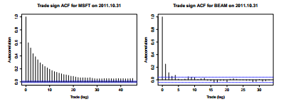
2.1.1. Trade autocorrelation
ACF of trade direction
Source: Bank of America Merrill Lynch

Slide 59
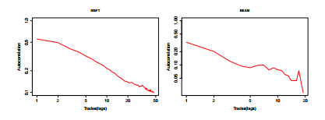
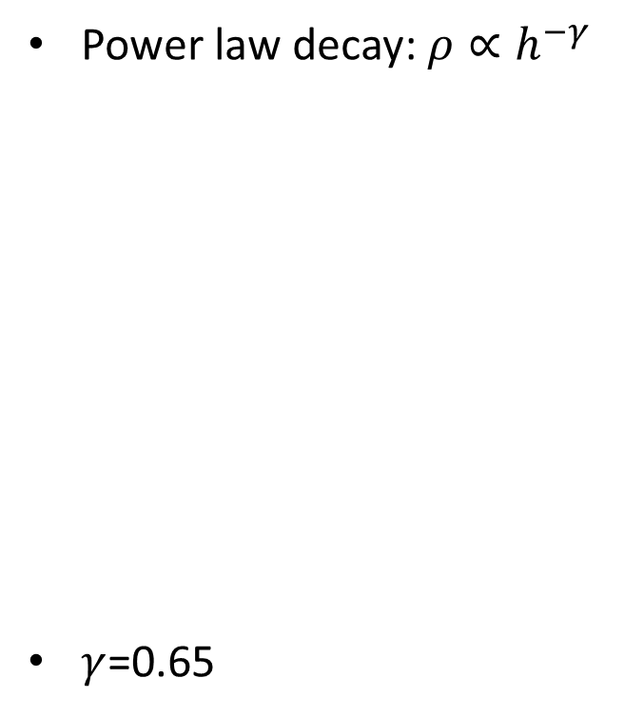
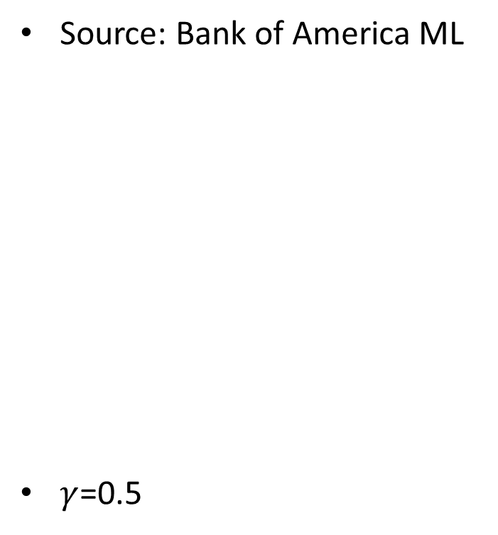
2.1.1. Trade autocorrelation
Log-log plot of the autocorrelation of trade signs
Source: Bank of America ML
$γ$=0.5
Power law decay: $ρ∝h^{−γ}$
$γ$=0.65

Slide 60
2.1.1. Trade autocorrelation
How to use it?
If we want to execute a large buy order:
Trade more aggressively when someone else is executing many sell orders
Trade less when everyone is buying

Slide 61
2.1.2. Event trading = special case
The basics of events
Event arbitrage step-by-step
Definition
An event is a recurrent news that moves the markets
Types of news suitable for event arbitrage
Corporate news
Analysts’ forecasts, earnings releases, a combination of the two (earnings surprises)
Industry news
Legal decisions, regulatory changes, announcements of new products
Macroeconomic news
Government statistics, monetary and fiscal policy decisions, private sector statistics
To construct event time series, follow a three-step process for event type of interest:
Identify dates and times of past events
Compute historical price changes for securities of interest
Estimate expected price response
Test response “out-of-sample”
Trade upon results

Slide 62
2.1.2. Macro Events
Time (ET) | Event | Prior Value | Consensus Forecast | Country
1:00 a.m. | Norway Consumer Confidence | –13.3 |  | Norway
1:45 a.m. | GDP Q/Q | 0.0 percent | –0.8 percent | Switzerland
1:45 a.m. | GDP Y/Y | 1.6 percent | –0.1 percent | Switzerland
2:00 a.m. | Wholesale Price Index M/M | –3.0 percent | –2.0 percent | Germany
2:00 a.m. | Wholesale Price Index Y/Y | –3.3 percent | –6.3 percent | Germany
3:00 a.m. | Norway PMI SA | 40.8 | 40.2 | Norway
4:30 a.m. | PMI Construction | 34.5 | 34.2 | UK
7:45 a.m. | ICSC Goldman Store Sales |  |  | U.S.
8:55 a.m. | Redbook |  |  | U.S
9:00 a.m. | Bank of Canada Rate | 1.0 percent | 0.5 percent | Canada
10:00 a.m. | Pending Home Sales | 6.3 percent | –3.0 percent | U.S.
1:00 p.m. | Four-Week Bill Auction |  |  | U.S.
2:00 p.m. | Total Car Sales | 9.6M | 9.6M | U.S.
2:00 p.m. | Domestic Car Sales | 6.8M | 6.9M | U.S.
5:00 p.m. | ABC/Washington Post Consumer Confidence | v48 | –47 | U.S.
5:30 p.m. | AIG Performance of Service Index | 41 |  | Australia
7:00 p.m. | Nationwide Consumer Confidence | 40 | 38 | UK
7:30 p.m. | GDP Q/Q | 0.1 percent | 0.1 percent | Australia
7:30 p.m. | GDP Y/Y | 1.9 percent | 1.1 percent | Australia
9:00 p.m. | ANZ Commodity Prices | –4.3 percent |  | New Zealand

Slide 63
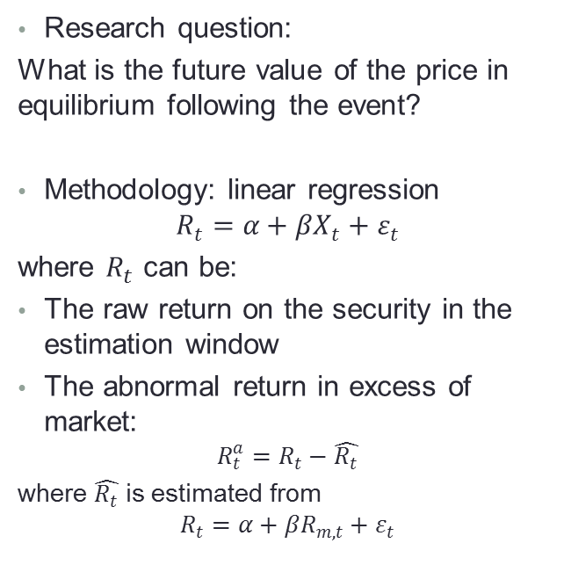
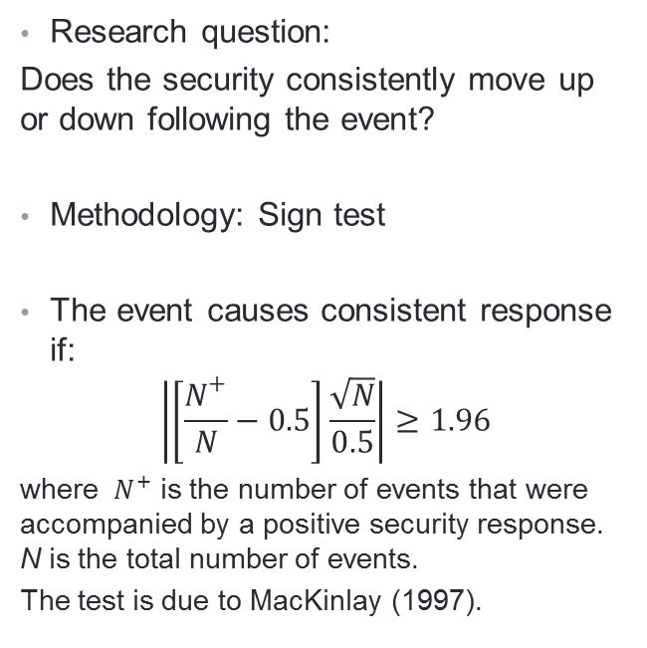
2.1.2. Methodology
Directional forecasts
Point forecasts
Research question:
Does the security consistently move up or down following the event?
Methodology: Sign test
The event causes consistent response if:
$$\left|\left[\frac{N^{+}}{N}−0.5\right]\frac{\sqrt{N}}{0.5}\right|≥1.96$$
where ${ N}^{+}$ is the number of events that were accompanied by a positive security response. N is the total number of events.
The test is due to MacKinlay (1997).
Research question:
What is the future value of the price in equilibrium following the event?
Methodology: linear regression
$$R_{t}=α+βX_{t}+ε_{t}$$
where $R_{t}$ can be:
The raw return on the security in the estimation window
The abnormal return in excess of market:
$$R_{t}^{a}=R_{t}−\hat{R_{t}}$$
where $\hat{R_{t}}$ is estimated from
$$R_{t}=α+βR_{m,t}+ε_{t}$$

Slide 64
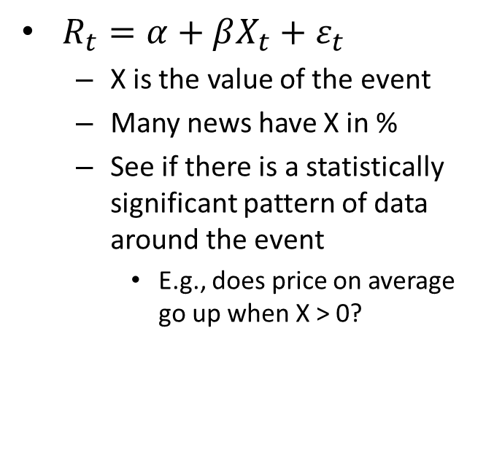
2.1.2. Step-by-step
Assemble data
Run analysis
Find most recent events
Rule of thumb: at least 30
Can change the number depending on model, results
Find the data surrounding the events
Tick data around each event
+/- 30 minutes “windows”
$R_{t}=α+βX_{t}+ε_{t}$
X is the value of the event
Many news have X in %
See if there is a statistically significant pattern of data around the event
E.g., does price on average go up when X > 0?

Slide 65
2.1.2. Applications
Nearly all securities markets
Foreign exchange
Documented event studies on:
Foreign exchange
Equities and ETFs
Fixed-income
Futures
Emerging markets
Commodities
Responds to:
GDP
Non-farm payroll
Retail sales
Industrial production
Capacity utilization
Personal income
Consumer credit
Personal consumption expenditures
New home sales
Durable goods orders
Construction spending
Factory orders
…

Slide 66
2.1.2. Applications (cont.)
Equities and ETFs
Fixed Income
Respond to:
Earnings announcements
Interest rate announcements
Inflation (higher inflation = lower stock returns)
Industrial production (higher industrial production = good news in recession, bad news in economic expansion)
Unemployment (higher unemployment = good news in economic expansions)
…
Many events contribute to equity volatility
Bond prices respond to:
Employment figures
Producer price index
Consumer price index
Within two minutes of the news release, bond prices respond to:
Durable goods orders
GDP
Housing starts
Leading indicators
Non-farm payroll
Retail sales
Trade balance

Slide 67
2.1.2. Applications (cont.)
Commodities and Futures
Emerging markets
Commodities respond to:
GDP
Inflation
Interest rates
Bond futures respond to:
Producer price index
Merchandise trade
Non-farm payrolls
Consumer price index
Futures prices respond within 1 minute
Futures volatility persists for 15 minutes post-announcement
Emerging market equities respond to:
U.S. macroeconomic news
USD-based exchange rate
Domestic interest rates
ASEAN equities are influenced by domestic variables:
GNP
CPI
Money supplies

Slide 68
2.1.2. Forex: EUR, GBP, USD
 | News Announcement Type
Region of News Origination | Increase in Prices or Money | Increase of Output | Increase in Trade Balance
Eurozone, Effect on EUR | Appreciation | Appreciation
UK, Effect on GBP | Appreciation | Appreciation | Appreciation
U.S., Effect on USD | Depreciation | Appreciation | Appreciation
Effect of Region-Specific News Announcements on the Respective Currency,
per Love and Payne (2008)

Slide 69
2.1.2. Fixed Income
Announcement | 3-Month Bill | 2-Year Note | 30-Year Bond
CPI | 0.593* | 1.472** | 1.296**
Durable Goods Orders | 1.275** | 2.180** | 1.170**
GDP | 0.277 | 0.379 | 0.167
Housing Starts | 0.670** | 1.406** | 0.731**
Jobless Rate | –0.939* | –1.318** | –0.158
Leading Indicators | 0.411** | 0.525* | 0.271*
Non-Farm Payrolls | 3.831** | 6.124** | 2.679*
PPI | 0.768** | 1.879** | 1.738
Retail Sales | 0.582* | 1.428** | 0.766**
Trade Balance | –0.138 | 0.027 | –0.062

Slide 70
Outline
What is Quantitative Analysis?
Quantitative strategies
Momentum
Trend following
Event trading
Mean reversion = statistical arbitrage
Basic case
Relative value
Basket tracking
High frequency strategies
Trend following
Statistical arbitrage
Market making

Slide 71
2.2. Mean-reversion = Stat Arb
Definition
Basic Methodology
Statistical arbitrage = trading on deviations from persistent statistical phenomena
Notes:
Phenomena can be spurious (the number of sun spots has been shown to influence stock returns)
Main criteria: the statistical phenomenon has to hold with probability of 90% or higher
In technical analysis, Bollinger Bands
For stat arb between any two securities:
Specify a relationship, e.g. $ΔS_{i,j,t}=S_{i,t}−S_{j,t}$
Find the most statistically stable relationship: $\min_{i,j}{\sum_{t=1}^{T}{{\left(∆S_{ij,t}\right)}^{2}}}$
Estimate distributional properties of the difference: $E=\frac{1}{T}\sum_{t=1}^{T}{∆S_{t}}$, $σ^{2}=\frac{1}{T−1}\sum_{t=1}^{T}{{\left(∆S_{t}−E\right)}^{2}}$
Monitor and trade upon statistical deviations from parameters:
Sell i and buy j if $S_{i,t}−S_{j,t}>E+2σ$
Buy i and sell j if $S_{i,t}−S_{j,t}<E−2σ$

Slide 72
2.2. What is Stat Arb?
Example
P1
P2
E + k σ
MA = E
P1-P2
Buy P2, Sell P1
Buy P1, Sell P2

Slide 73
2.2. Methodology
Cointegration
Trading
Two instruments:
$R_{1}=α+βR_{2}+ε_{1}$
$R_{2}=α+βR_{1}+ε_{2}$
Three instruments:
$R_{1}=α+βR_{2}+βR_{3}+ε_{1}$
$R_{2}=α+βR_{1}+βR_{2}+ε_{1}$
$R_{3}=α+βR_{1}+βR_{2}+ε_{1}$
Portfolio
2,000 stocks, for example
By Law of One Price:
The price of a basket has to equal the weighted sum price of the underlying
If left-hand side of the equation is greater than right-hand side:
Sell left-hand side
Buy right-hand side
And vice versa

Slide 74
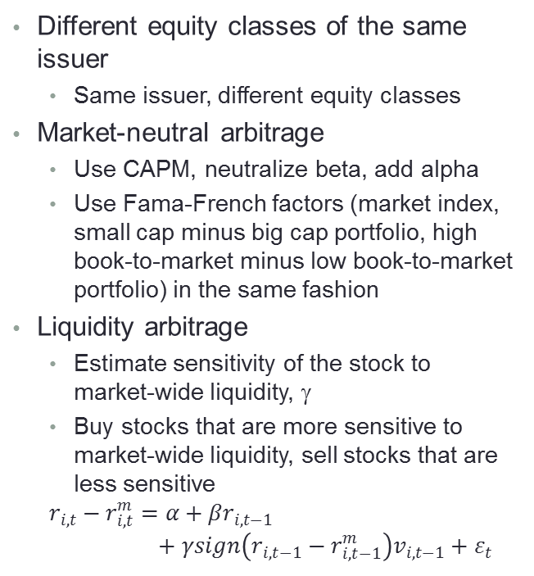
2.2. Stat-Arb Applications
Equities
Other Securities
Different equity classes of the same issuer
Same issuer, different equity classes
Market-neutral arbitrage
Use CAPM, neutralize beta, add alpha
Use Fama-French factors (market index, small cap minus big cap portfolio, high book-to-market minus low book-to-market portfolio) in the same fashion
Liquidity arbitrage
Estimate sensitivity of the stock to market-wide liquidity, γ
Buy stocks that are more sensitive to market-wide liquidity, sell stocks that are less sensitive
$$r_{i,t}−r_{i,t}^{m}=α+βr_{i,t−1}+γsign\left(r_{i,t−1}−r_{i,t−1}^{m}\right)v_{i,t−1}+ε_{t}$$
Futures:
Futures/equity arbitrage
Equity futures adjust to macro events quicker than spot
ETFs and other indices
Index/basket arbitrage
A basket of securities included in the index should have the same returns as the index (by the Law of One Price)
If the prices diverge, sell more expensive one, buy cheaper one.

Slide 75
2.2. Example: Dual-class shares
Principle
Two common equity classes issued by the same company trade within a relatively constant price range from each other
Different classes of common equity diverge in:
voting rights
number of shares outstanding.
Better voting rights => higher price
More shares => higher price
Differences are stable
Blockbuster, Inc.; Chipotle; Forest City Entertainment; Greif, Inc.; John Wiley & Sons; K V Pharma; Lennar Corp.; and Moog, Inc.

Slide 76
2.2. Dual-class shares
Company Name | Ticker Class A | Class A Close | Class A Volume (MM Shares) | Ticker Class B | Class B Close | Class B Volume (MM Shares)
Blockbuster, Inc. | BBI | 1.59 | 2.947 | BBI-B | 0.88 | 0.423
Chipotle | CMG | 60.38 | 0.659 | CMG-B | 55.87 | 0.156
Forest City Entertainment | FCE-A | 8.49 | 1.573 | FCE-B | 8.41 | 0.008
Greif, Inc. | GEF | 35.42 | 0.378 | GEF-B | 35.15 | 0.016
John Wiley & Sons | JW-A | 36.82 | 0.237 | JW-B | 36.63 | 0.005
K V Pharma | KV-A | 3.68 | 0.973 | KV-B | 3.78 | 0.007
Lennar Corp. | LEN | 11.17 | 8.743 | LEN-B | 8.5 | 0.074
Moog, Inc. | MOG-A | 37.52 | 0.242 | MOG-B | 37.9 | 0.000

Slide 77
2.2. Risk-neutral Arb
Principle
Capital Asset Pricing Model (CAPM):
is the return on security i at time t
is the return on a broad market index achieved in time period t
is the risk-free interest rate, such as Fed Funds rate
The equation can be estimated using Ordinary Least Squares (OLS) regression
Want betas that are similar

Slide 78
2.2. Risk-neutral Arb
Same betas, Different Alphas
Variations
Alpha difference:
Statistically significant
Exceeding trading costs
Other factors:
Small Minus Big: difference in returns between market indices or portfolios of small and big-cap stocks
High minus Low: return on stocks with high book-to-market ratios less returns on stocks with low book-to-market ratios

Slide 79
2.2. Liquidity Arbitrage
Principle
A financial instrument that offers some inconvenience to investors should offer higher returns to compensate investors for the inconvenience
Low liquidity = inconvenience
May not be able to liquidate fast enough
Trading on liquidity alone does not do much
Have to first adjust for market movements:
Excess return
Dependent variables:
Return
Volume
Sign of return

Slide 80
2.2. Triangular Arb
Forex
If market ask for EUR/CAD is lower than synthetic bid for EUR/CAD:
buy market EUR/CAD,
sell synthetic EUR/CAD,
wait for the market and synthetic prices to align, then reverse the position capturing the profit.

Slide 81
2.2. Uncovered Interest Parity Arbitrage
Futures on anything: E[S_t+1] = futures price, S_t = price of underlying
To trade, estimate dependency:
When out of sync with alpha and beta, sell overpriced, buy underpriced
Can also be a “calendar spread”

Slide 82
2.2. Index Arb
Principles
Example
Law of one price:
A basket of many stocks should be priced as such
P_all = P1+P2+P3+…+PN
If portfolio costs more than right-hand side:
Sell portfolio
Buy right-hand side

Slide 83
Outline
What is Quantitative Analysis?
Quantitative strategies
Momentum
Trend following
Event trading
Mean reversion = statistical arbitrage
Basic case
Relative value
Basket tracking
High frequency strategies
Trend following
Statistical arbitrage
Market making

Slide 84
3. Recent Developments
Technology impact on markets:
Investors automate their trading (Hendershott and Riordan, 2009)
Most markets are electronic limit order books (Jain, 2005)
Use of trading algorithms is on the rise;
Automate trading decisions
Submit orders
Manage orders post-submission
Buy-side and sell-side engage in high-frequency trading
Sell-side must understand buy-side trading strategies to avoid being picked off

Slide 85
3. Algorithms
Two types:
High-frequency trading: arbitrage of intraday market inefficiencies
Includes market-making
Order-splitting facilitation of execution
To minimize market impact, associated costs
The two types of trading algorithms are often confused

Slide 86
3. Algo Trading and HFT
“Algo execution”
Electronic
Interface
Broker-Dealer
Run-Time Processor
Proprietary software technology
Process real-time quotes
Perform run-time econometrics
Develop buy and sell signals
Calculate run-time P&L,
Risk management based on pre-defined parameters
Generate order and fulfillment record for future reconciliation
Services:
Quotes
Order Processing
Trade Reconciliation
Live Quotes
Archive all quotes received
Buy/Sell Orders
USD/CAD
Human Element
Run-time performance monitoring
Innovation in strategy development/enhancement
Simulation Engine
Proprietary software technology
Generates and tests new strategies
Enhances current trading strategies based on the results generated in the post-trade analysis
Post-Trade Analysis
Proprietary software technology
Reconciles daily trades with simulation results based on archived data
Identifies slippages, anomalies and other discrepancies
© Copyright Irene Aldridge 2012

Slide 87
3. HFT Strategies
Momentum and Stat-arb
Market making is different
Same as low frequency
… but much faster
HFT Market Making – a simple example
Common Questions and Issues
Enhancements and Scalability
Liquidity and Quote Stuffing
Trading Speed and Regulatory Impact
How can sell-side attract buy-side flow?

Slide 88
3. HFT Market Making – How to open positions?
Process to open positions
At what prices to set bids and offers?
Identify gaps in demand or supply
Various intelligent forecasting techniques
See the High-Frequency Trading book
Fill these gaps
Low demand: post bids
Low supply: post offers (asks)
Speed is of the essence:
Quickly grab the “customer”: fill in the void in demand and supply
Orders better than the current best bid/ask are most profitable
Orders far from the best bid and offer do not execute fast enough
Both sell-side and buy-side HFTs are better off opening positions aggressively

Slide 89
3. HFT Market Making – How to close positions?
Aggressive orders?
Passive orders?
Closer to or better than best bid/ask
Aggressive closing orders allow more volume
Great for sell-side
Far away from the market
Passive closing orders bring potentially bigger gain
Passive orders can be riskier (the risk of being run over by market)
Better for buy-side
Sell-side HFT is better off closing aggressively, while buy-side HFT can close passively.

Slide 90
3. HFT Market Making – Sell-side HFT and buy-side HFT comparisons
Sell-side Perspective
Buy-side Perspective
Objective:
To capture alpha AND commission income
Optimal implementation:
High volume (high commissions revenue)
Small gains per trade
Aggressive position open to capture opportunities
Aggressive position close to maximize capital turnover
Objective:
To capture alpha and minimize transaction costs
Optimal implementation:
Smaller volume (low transaction expense)
Larger gains per trade
Aggressive position open to capture opportunities
Passive position close to maximize per trade profitability

Slide 91
3. HFT Market Making – implications for all market makers
On position open
On position close
Buy-side HFTs compete with sell-side HFTs to fill the void in supply and demand
Both buy-side HFT and sell-side HFT use aggressive orders
Manual execution has an ample range of passive orders at their disposal
Sell-side HFTs use aggressive orders, while buy-side HFTs use passive orders.
Manual execution is “squeezed,” describe the phenomenon as “flashing quotes,” cannot compete.

Slide 92
3. HFT Market Making – implications for all market makers
On position open
Sell-side HFT
Buy-side HFT
Manual execution
Manual execution
Bids
Market price
Asks
On position close
Buy-side HFT
Sell-side HFT
Buy-side HFT
Manual
Manual
Bids
Market price
Asks

Slide 93
3. HFT Market Making – implications for all market participants
Who wins?
Who loses?
HF traders
End investor (“mom-n-pop”, institutional investors) gain:
Higher liquidity
Lower costs
Manual execution squeezed
Can’t compete
Too inefficient, not fast enough, priced too high (too much overhead – too many traders, etc.)
HFT market-making will become the standard.

Slide 94
3.1 Naïve market-making
Project
Enhancements
Build a naïve market-making system
Use trade data for NYSE
Place double-sided orders
Assume an order is executed only when the latest trade price “crosses” the order
Offset limit orders 1, 2, 3 … ticks away from the market
Volatility-dependent offset:
${offset}_{t}=round\left(\frac{1}{T}\sum_{τ=t−1}^{t−T}{{(P_{τ}−P_{τ−1})}^{2}}\right)$
What happens?

Slide 95
3.1 Naïve market-making
Project
Enhancements
Build a naïve market-making system
Use trade data for NYSE
Place double-sided orders
Assume an order is executed only when the latest trade price “crosses” the order
Offset limit orders 1, 2, 3 … ticks away from the market
Volatility-dependent offset:
${offset}_{t}=round\left(\frac{1}{T}\sum_{τ=t−1}^{t−T}{{(P_{τ}−P_{τ−1})}^{2}}\right)$
What happens?
PROJECT!

Slide 96
3.2 Enhancements: find lack of liquidity and provide it
Direct measures of liquidity
Indicators of liquidity pools
The tightness of the bid-ask spread
Bid-ask spread = the cost of instantaneous reversal of position
Market depth: size at best bid, best ask
Size of the order that can be processed immediately
Market resilience
How quickly the market price mean-reverts to its equilibrium following a random order flow
Price sensitivity to block transactions, λ (Kyle, 1985): smaller λ, larger liquidity
$ΔP_{t}=α+λ\left(|V_{t}|\right)+ε_{t}$
Shape of the order book establishes concentrations of liquidity
Cao, Hansch, Wang (2004) order book:
Market price

Slide 97
3.2 Liquidity Enhancements
Technical liquidity pointers
Mathematically…
Technical indicators identify hidden liquidity pools:
Kavaiecz and Odders-White (2004): traders are likely to place orders at support and resistance levels.
Therefore, support and resistance levels correspond to liquidity peaks
Support levels:
${SL}_{t+1}=\min\left(P_{t}\right)+\left(\min\left(P_{t}\right)−min⁡(P_{t−1})\right)$
Resistance levels:
${RL}_{t+1}=\max\left(P_{t}\right)+\left(\max\left(P_{t}\right)−max⁡(P_{t−1})\right)$

Slide 98
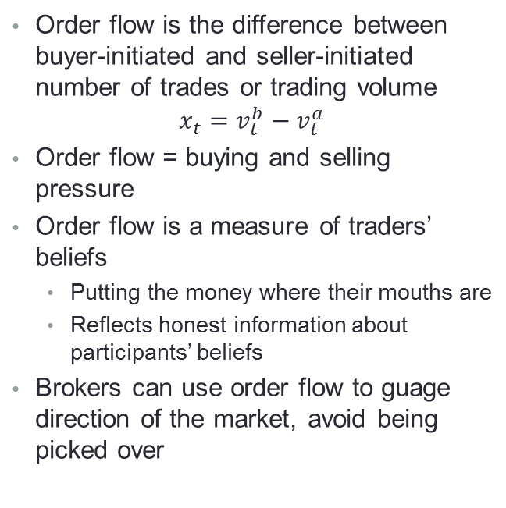
3.2 Look at Order Flow to Avoid Pick Over?
Background
Order flow moves markets
Order flow is the difference between buyer-initiated and seller-initiated number of trades or trading volume
$$x_{t}=v_{t}^{b}−v_{t}^{a}$$
Order flow = buying and selling pressure
Order flow is a measure of traders’ beliefs
Putting the money where their mouths are
Reflects honest information about participants’ beliefs
Brokers can use order flow to guage direction of the market, avoid being picked over
Order flow accounts for at least 50% of information impounded into market prices
Love and Payne (2008): examine impact of macro news on USD/EUR, GBP/EUR and USD/GBP
USD/EUR level follows order flow after a news release from Eurozone
GBP/EUR and USD/GBP levels follow order flow after a news release from the U.K.
USD/EUR and USD/GBP levels follow order flow after a news release from the U.S.
Other studies: Lyons (1995), Perraudin and Vitale (1996), Evans and Lyons (2002), Jones, Kaul, and Lipson (1994)

Slide 99
3.2 HFT Market Making – a simple algorithm with liquidity
Are these low liquidity conditions?
No
Market quote stream
Receive quotes
Yes
Set position exit conditions
Open liquidity-providing positions

Slide 100
3.2 HFT Market Making – performance of the simplest algorithm
Model ID | 1 | 2 | 3 | 4 | 5 | SPY
Open order aggressiveness | BB+0.02/ BO-0.02 | BB+0.02/ BO-0.02 | BB+0.02/ BO-0.02 | BB+0.03/ BO-0.03 | BB+0.05/ BO-0.05
Closing order aggressiveness | BB-0.05/ BO+0.05 | BB-0.10/ BO+0.10 | BB-0.20/ BO+0.20 | BB-0.50/ BO+0.50 | BB–0.80/ BO+0.80
Sum Gain % | -227.4% | -181.7% | 196.3% | 222.9% | 429.4% | 5.5%
Daily Average | -2.1% | -1.7% | 1.8% | 2.0% | 3.9% | 0.05%
Stdev | 45.2% | 48.3% | 53.2% | 52.2% | 53.8% | 1.3%
Avg # orders | 41.7 | 39.7 | 39.2 | 38.7 | 38.0
Avg # trades | 11.3 | 7.2 | 4.7 | 3.7 | 2.1
Avg daily execution rate | 21.6% | 14.8% | 9.8% | 7.8% | 4.7%
BB = best bid, BO = best offer
2/1/2010-7/28/2010, only 100 shares of SPY traded at all times

Slide 101
3.2. Market-making orders
Market-making orders form order books
Order books have “universal” average properties
Limit orders
Reflect beliefs of true values of securities
Executed only when market price “crosses” the order
Are often far from the market
Bouchaud, Mezard, Potter (2002) report that limit orders can be found at +/- 50% of the current best price on Paris Bourse
Zovko and Farmer (2002) report similar results for London Stock Exchange
The number of far-from-market orders increases during times of high volatility
Symmetrical around current best price
Maximum around current best price
Likelihood of observing a limit order $∆ away from the market price follows power law:
$$P\left(∆\right)∝\frac{∆_{0}^{μ}}{{(∆_{1}+∆)}^{1+μ}}$$
Bouchaud, Mezard and Potter (2002): µ=0.6 (Paris Bourse)
Zovko and Farmer (2002): µ=-1.5 (London Stock Exchange)
$∆_{0}, ∆_{1}$ are security-specific parameters
Current market
price
bids
asks
Market-making strategies are applicable to different markets

Slide 102
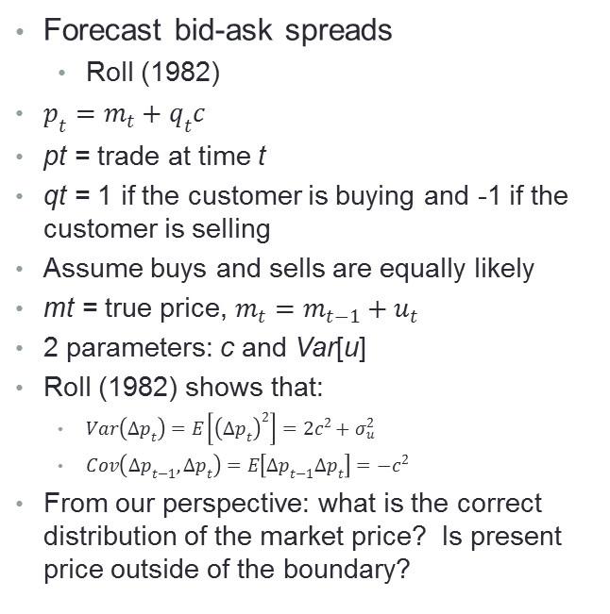
3.2 Bid-ask spread models
Bid-ask spread carries info
Bid-ask spread models
Liquidity
Wider spread = lower liquidity
News
Wider spread = more uncertainty
Wider spread = more ambivalence about the news
Wider spread = higher dealer’s estimate of information asymmetry (presence of better informed traders)
Example!

Slide 103
3.3. Informational MM: Reading the tape: an exercise
Ask_{t}
*
Mid_{t}
Bid_{t}
*
*
Time
Sell
Buy
Sell
Ask_{t}
Mid_{t}
Bid_{t}
*
Time
Sell
Ask_{t}
Mid_{t}
Bid_{t}
*
Time
Sell
Buy
Sell

Slide 104
3.3. Reading the tape: an exercise
Normal conditions:
No news
Market does not move
Trading at bid and ask
Dealer covers order processing costs
Large sell order:
Market impact observed
dealer temporarily lowers the prices to encourage distribution of present inventory, discourage new sell orders
Dealer eats inventory risk
Asymmetric information
Shift in price level
The dealer’s counterparty was likely an “informed trader:” possessed better information than the market-maker
Dealer is subject to adverse selection
Ask_{t}
*
Mid_{t}
Bid_{t}
*
*
Time
Sell
Buy
Sell
Ask_{t}
Mid_{t}
Bid_{t}
*
Time
Sell
Ask_{t}
Mid_{t}
Bid_{t}
*
Time
Sell
Buy
Sell

Slide 105
3.3 Inter-tick models: step-by-step
Regression model
Duration model
Decide on:
The data to use (quotes, trades, sizes or all of the above)?
Time intervals (e.g., 1 second)
Create a data series with corresponding price levels or returns:
Time -> Last duration -> Price -> Return
Run a linear regression:
$$ΔP_{t}=R_{t}=α+βd_{t}+ε_{t}$$
If β is statistically significant, test model “out-of-sample.” If not, change time interval, LHS variable
Poisson model:
Probability of exactly k ticks arriving between times t and τ is:
$$P\left[\left(N\left(t+τ\right)−N\left(t\right)\right)=k\right]=\frac{1}{k!}e^{−λτ}{(λτ)}^{k}$$
$$k=0,1,2,…$$
where λ is the average rate of arrival of ticks.
One way to use the model: look for outliers in duration behavior:
Estimate λ
If the model predicts 90% probability of no ticks in an interval, and we get 5 ticks => what are the average consequences for returns? For volatility?

Slide 106
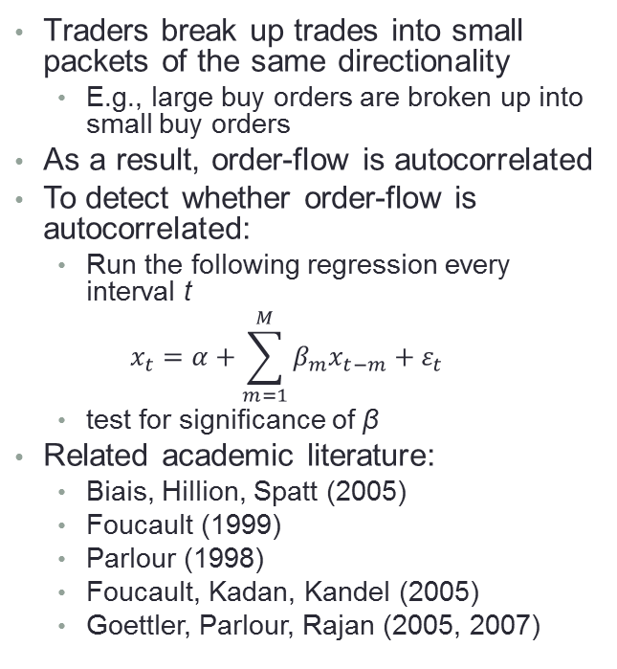
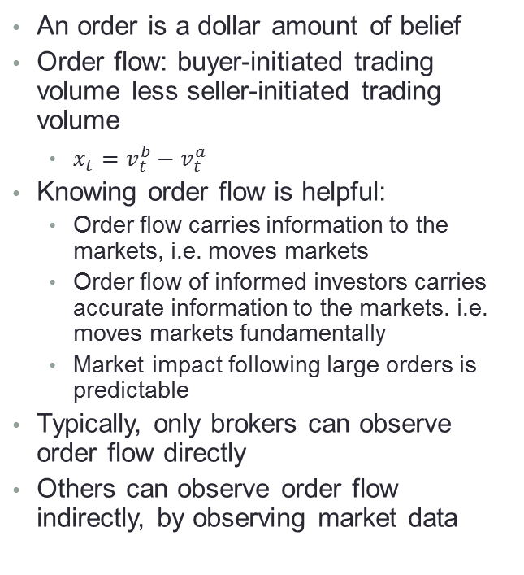
3.3 Reconstructing order flow
Order flow = belief x $$
Detecting trading orders
An order is a dollar amount of belief
Order flow: buyer-initiated trading volume less seller-initiated trading volume
$x_{t}=v_{t}^{b}−v_{t}^{a}$
Knowing order flow is helpful:
Order flow carries information to the markets, i.e. moves markets
Order flow of informed investors carries accurate information to the markets. i.e. moves markets fundamentally
Market impact following large orders is predictable
Typically, only brokers can observe order flow directly
Others can observe order flow indirectly, by observing market data
Traders break up trades into small packets of the same directionality
E.g., large buy orders are broken up into small buy orders
As a result, order-flow is autocorrelated
To detect whether order-flow is autocorrelated:
Run the following regression every interval t
$$x_{t}=α+\sum_{m=1}^{M}{β_{m}x_{t−m}}+ε_{t}$$
test for significance of β
Related academic literature:
Biais, Hillion, Spatt (2005)
Foucault (1999)
Parlour (1998)
Foucault, Kadan, Kandel (2005)
Goettler, Parlour, Rajan (2005, 2007)

Slide 107
Outline
What is Quantitative Analysis?
Quantitative strategies
Momentum
Trend following
Event trading
Mean reversion = statistical arbitrage
Basic case
Relative value
Basket tracking
High frequency strategies
Trend following
Statistical arbitrage
Market making

